Slide 1
Publisher
Publisher logo

Slide 2
Developer
Developer logo

Slide 3




Entrance
Potion Store Simulator
Player
select
Setting
Credits
Achievements
New Game
Load
Exit

Slide 4
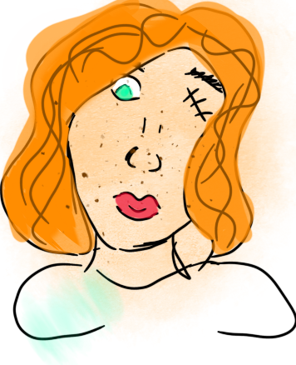
Character creator
Back
Insert Name
M
F
Hair
Hair Color
Face
Skin color
Continue
Eye Color

Slide 5
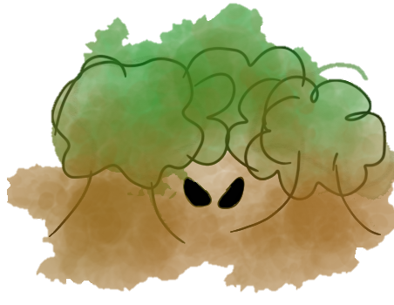






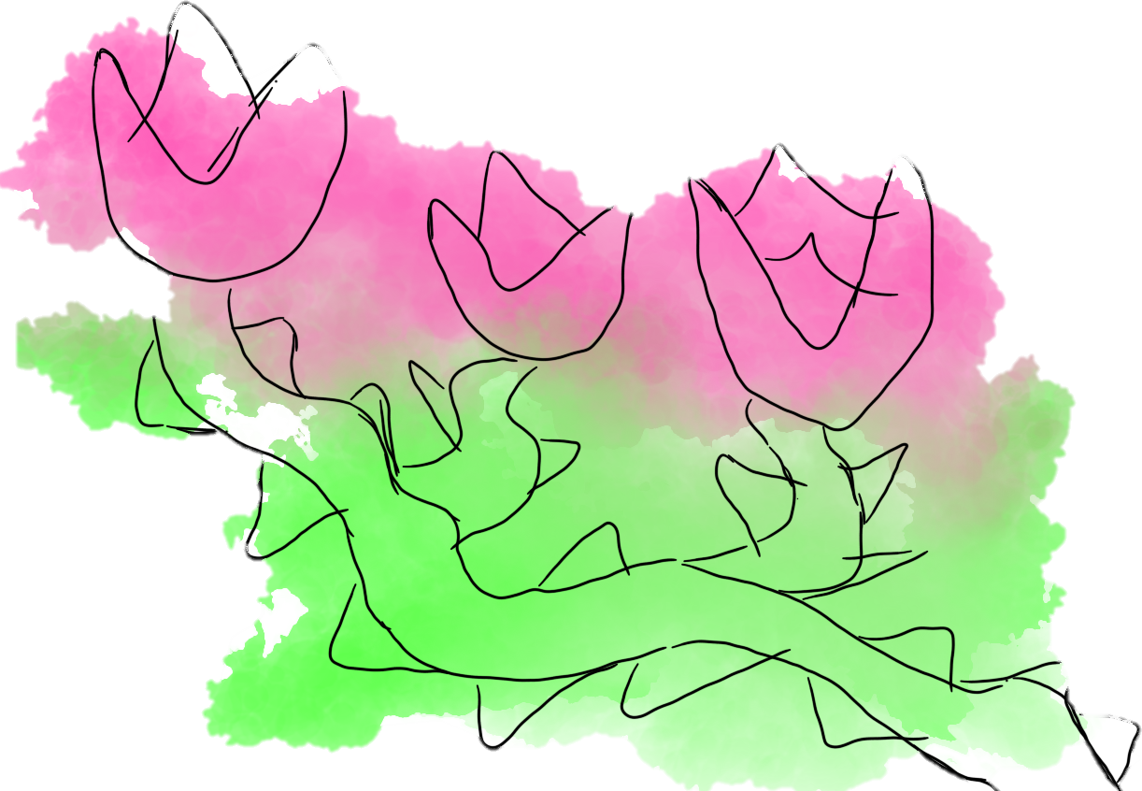

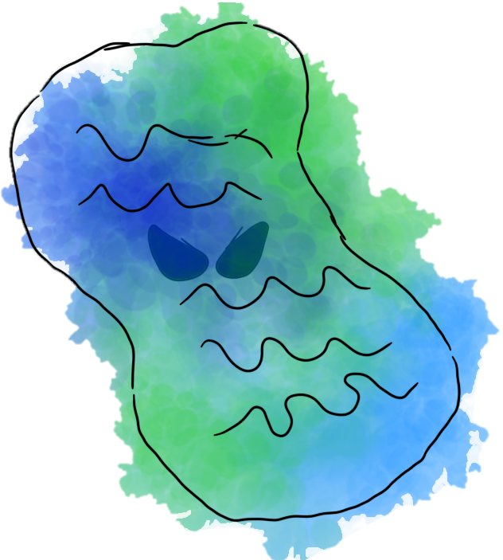
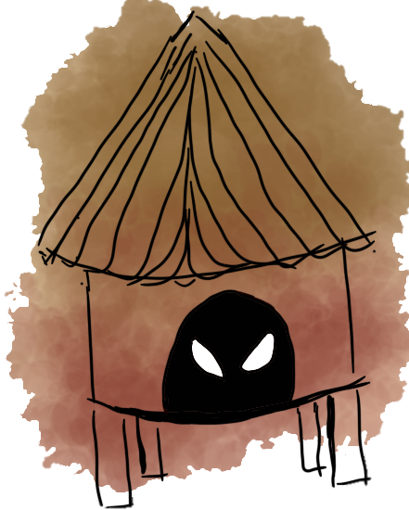
Game
Settings
Black
8
Red
4
Blue
5
Green
3
exit
10
7
6
3
2
1
ingredient
To the Wilds
To Garden
ingredient
ingredient
To Animal hut
To Pond
To Shop

Slide 6
exit
Black
8
Red
4
Blue
5
Green
3
exit
10
7
6
3
2
1
Main Menu
ingredient
To the Wilds
To Garden
ingredient
ingredient
Computer
To Animal hut
To Pond
To Shop

Slide 7


Animal hut
Back
Tools

Slide 8
Garden
Back
Tools

Slide 9
Pound
Back
Tools

Slide 10
Wilds
Back
Tools

Slide 11
Shop
Back
Buy
Sell
Coin
!8

Slide 12
Load game
Back
Save Files
Save 1
Save 2
Save 3
Save 4
Save 5

Slide 13
Settings
Back
Master audio
light
Music
Camera
Background
Language
Voices
Flash
action
Color blind

Slide 14
Player select
Back
Players
Lilly
Zombieboy
LOL
Crime
Steve

Slide 15
achivments
Achievements
Back
Wow some many trees
First ingredients harvest
Bubble Bubble toil and trouble
First Potion
Kinda looks like mud
First Mixed potion
Hmm cherry with a bit of blue berries
First Mostly red potion
Hmm Blue berries with a bit of cherry
First Mostly blue potion

Slide 16
Credits
Credits Scroll
Back

